Slide 1

Device Class
Attributes and Methods

Slide 2
Purpose
The Device class is the base class which defines attributes used within both the phone and tablet classes.
This class provides information to the derived classes about model, price, and release year.

Slide 3
Attributes
Strings
model: What model is the device
price: Cost of the device
Integer
releaseYear: Year device was released

Slide 4
Methods
Setters
setModel: assigns model of device
setReleaseYear: sets device production year
setPrice: sets device prices
Getters
getModel: returns model
getReleaseYear: returns device year
getPrice: returns device price

Slide 5
Methods cont…
displayData:
This method displays all product information such as Model Name, Production Year, and Price. Both Phone and Tablet classes call this method to display their respective information.

Slide 6
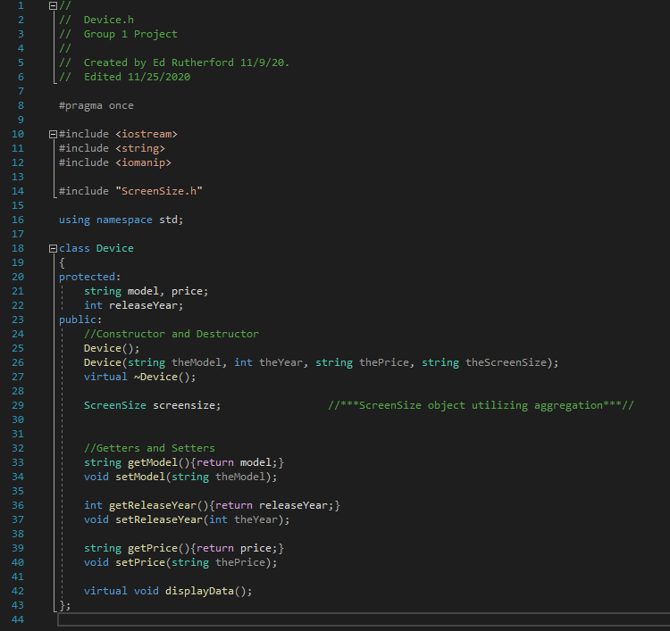
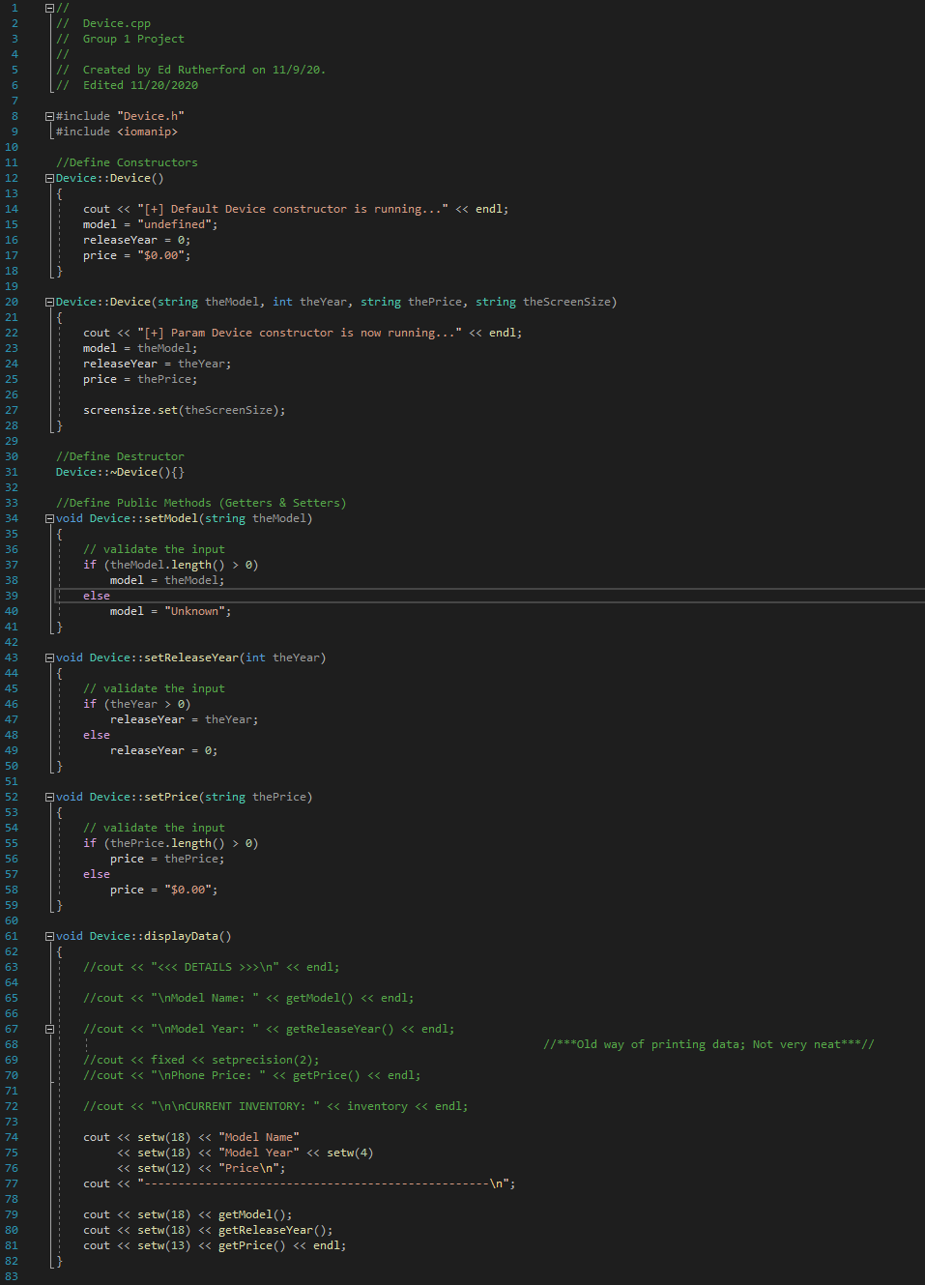
Device Class Code Screenshot

